Slide 1

Chatbots & Conversational AI: College Enquiry Chatbot
This project report by Ayush Mishra and Aryan Hayaran from Dayananda Sagar University explores the design and implementation of a College Enquiry Chatbot using Artificial Intelligence and Machine Learning. The chatbot aims to automate responses to student queries regarding admissions, courses, fees, and facilities, providing 24/7 support to enhance user experience and reduce administrative workload.
By,
Ayush Mishra (ENG22AM0080)
Aryan Hayaran (ENG22AM0077)

Slide 2

Introduction and Scope of the College Enquiry Chatbot
Introduction
Educational institutions face high volumes of repetitive inquiries, especially during admission periods. The chatbot uses conversational AI with NLP and logistic regression to classify user intent and provide instant, accurate responses.
Scope
The chatbot covers queries on academic courses, admissions, fees, facilities, and more. It operates 24/7, reduces administrative workload, integrates with existing platforms, and offers personalised interactions for different user types.

Slide 3
Problem Definition and Literature Survey
Problem Definition
Literature Survey
Manual handling of student inquiries is inefficient, time-consuming, and prone to errors. The chatbot aims to automate frequent questions, process natural language inputs, provide consistent information, and improve user experience.
IBM Watson Assistant and Google Dialogflow are popular chatbot platforms with NLP modules.
AI chatbots learn from data and generate dynamic responses, unlike rules-based chatbots.
Logistic regression is a common technique for intent classification.
Educational chatbots improve student motivation and reduce administrative burden.

Slide 4
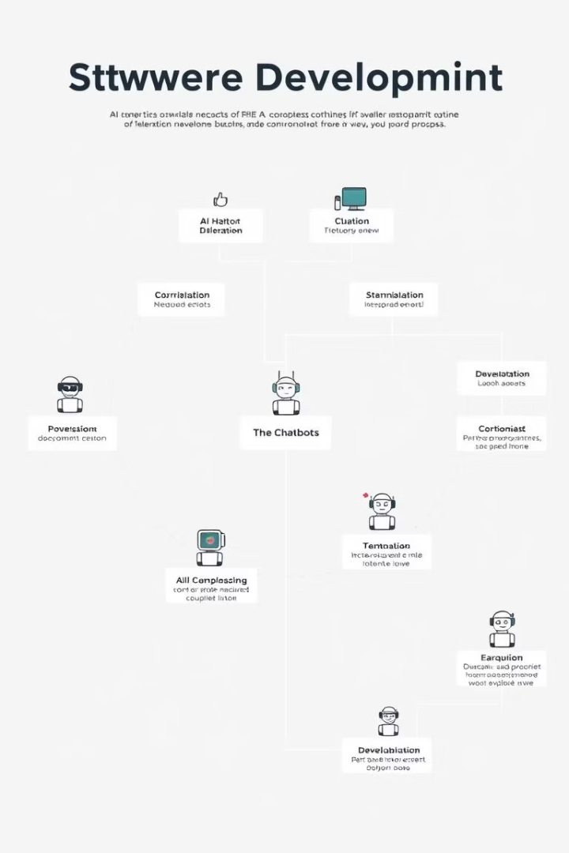




Methodology: Design and Implementation
Requirement Analysis
Identify user types and FAQs to target for chatbot responses.
Data Collection & Preprocessing
Gather data from college websites, FAQs, brochures, and staff interviews; clean and vectorize text using NLP techniques.
Model Training & Bot Design
Train logistic regression model for intent classification; design dialogue flow and error handling.
Integration & Testing
Connect model with web interface using Flask; conduct unit and integration tests with user feedback.

Slide 5
Data Collection and Pre-processing
Data Collection
Data Pre-processing
Official college websites and prospectus
Text cleaning: removing HTML, URLs, numbers, special characters
Student portals and help desk FAQs
Email and chat transcripts
Tokenization and stop-word removal
Interviews with administrative staff
Stemming and lemmatization
Vectorization using TF-IDF
Labeling queries by intent categories

Slide 6
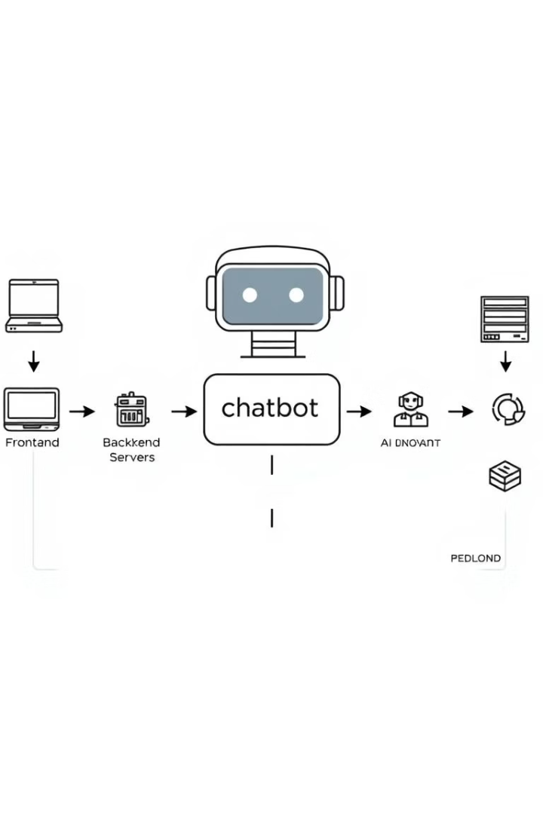
System Architecture and Requirements
System Architecture
Hardware & Software Requirements
Frontend: HTML, CSS, JavaScript interface with chat window. Backend: Python Flask framework running NLP model and handling requests.
Intel i5 processor or higher, 4-8 GB RAM, 20GB disk space
Python 3.8+, Flask, NLTK or Spacy, web browser, GIT, virtual environment
Functional & Non-Functional Requirements
Intent recognition, multi-turn conversation, 99% availability
Simple interface, scalability, maintainability, data privacy and security

Slide 7
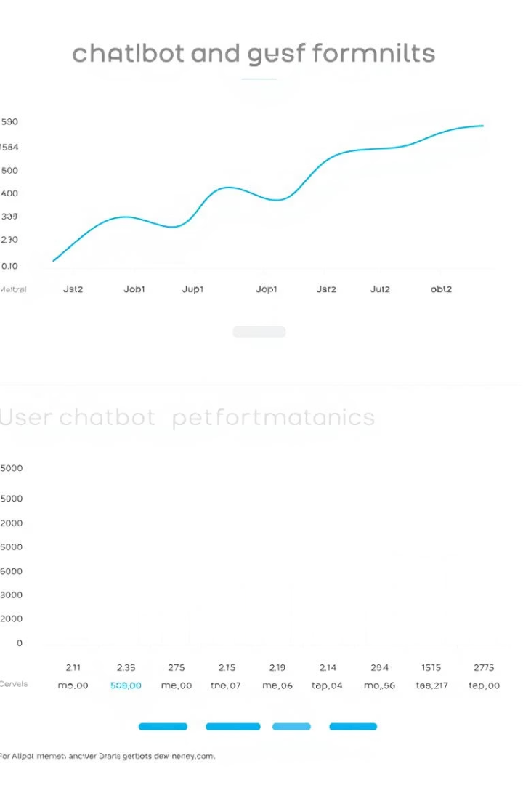
Results, Analysis and Impact
The College Enquiry Chatbot prototype effectively classifies user intents using logistic regression, providing timely and accurate responses. It reduces administrative workload and enhances user experience by offering 24/7 support. The system demonstrates scalability and potential for integration with other college services, contributing to smarter AI-enabled educational infrastructure.
This innovation aligns with Sustainable Development Goals by improving access to education, fostering innovation, and reducing inequalities through unbiased, accessible information delivery.

Slide 8
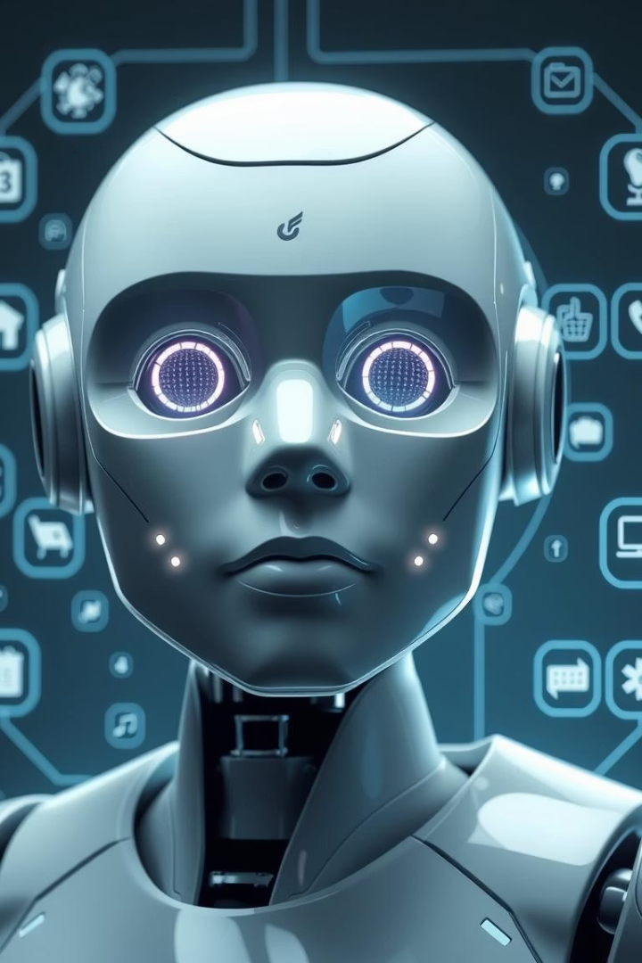
Conclusion and Future Work
Conclusion
The project successfully applies AI to automate college enquiries, improving efficiency and user satisfaction. Logistic regression proves effective for intent classification in this prototype system.
Future Enhancements
Voice-based interaction with speech-to-text and text-to-speech modules
Multilingual support for regional and international languages
Advanced deep learning models like BERT or LSTM for complex queries
Chat analytics for trend analysis and improved responses
Mobile app and third-party system integrations

